Slide 1

P peline
The Data
Introductory Statistics: Correlation & Causality
© Jennifer Mankoff
The Data Pipeline; HCII; Spring 2014

Slide 2

Leibovici, L. (2001). Effects of remote, retroactive intercessory prayer on outcomes in patients with bloodstream infection: Randomised controlled trial. Bmj, 323(7327), 1450-1451.
Notes:
HAND OUT ARTICLE, READ and discuss.
Can you envision a study that would convince you that a cause can lead to something happening in the past?

Slide 3
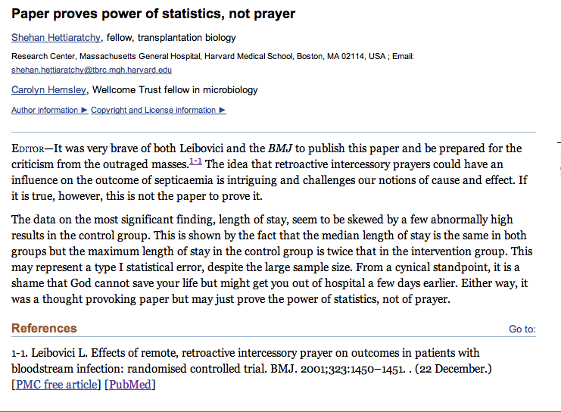
Adapted from class by Samantha Kleinberg

Slide 4
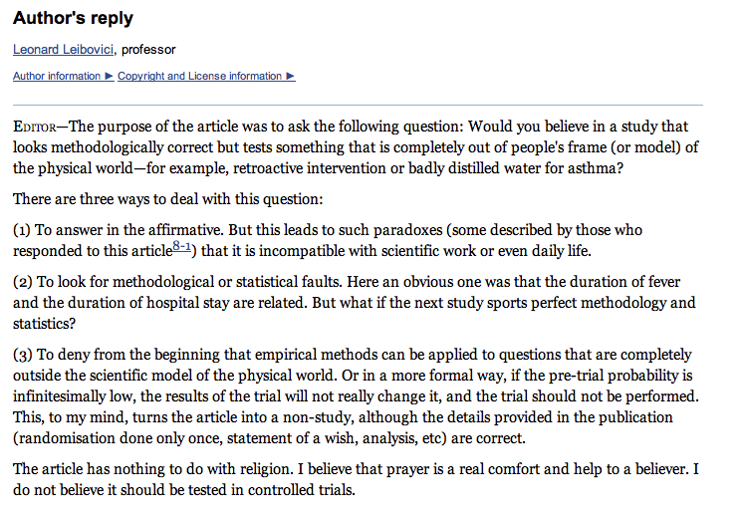
Leibovici’s reply
Adapted from class by Samantha Kleinberg
Notes:
http://www.ncbi.nlm.nih.gov/pmc/articles/PMC1122963/

Slide 5
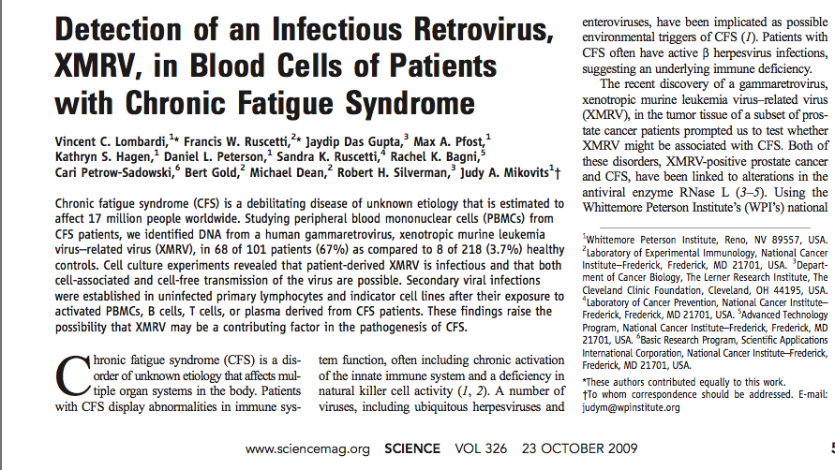
XMRV leads to CFS?
Adapted from class by Samantha Kleinberg

Slide 6
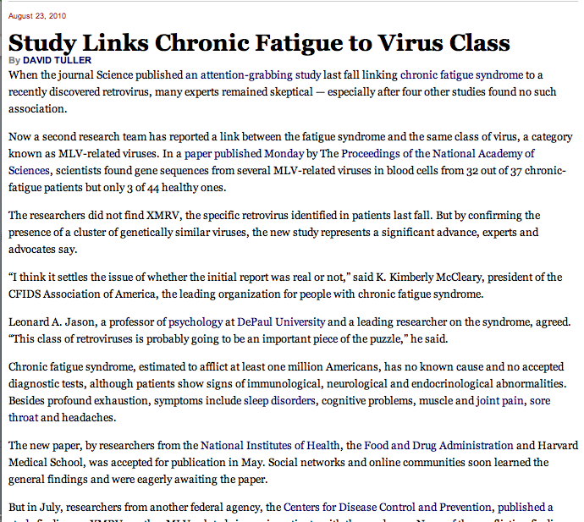
XMRV leads to CFS?
“I think it settles the issue of whether the initial report was real or not”
Adapted from class by Samantha Kleinberg

Slide 7
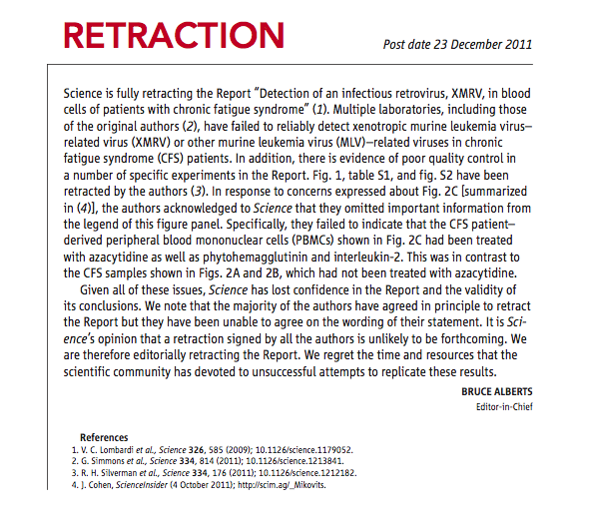
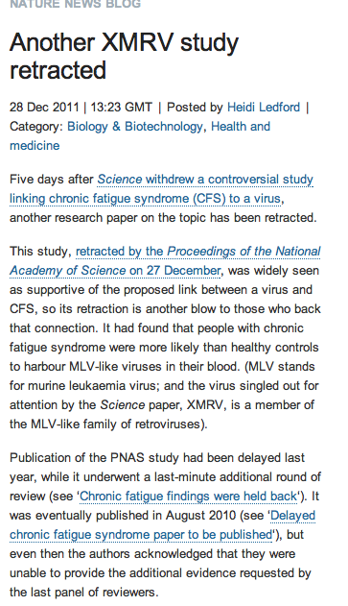
But …
Adapted from class by Samantha Kleinberg
Notes:
http://www.nature.com/news/the-scientist-who-put-the-nail-in-xmrv-s-coffin-1.11444
March 2011
Scientists at NIH present research showing that XMRV emerged from two different mouse viruses in the laboratory during the 1990s. The implication, one author told Nature, is that this virus, born in a laboratory, has probably been infecting laboratory samples for more than a decade, but not people. Meanwhile, a Nature profile of Judy Mikovits highlights growing tensions between Mikovits and her former collaborators on the initial report.

Slide 8
Goals
After this, you should be able to:
Understand how to diagram the relationships between variables
Explain the concept of causation

Slide 9
Process vs Frequency data
Formulate
hypotheses
(Collect) & Analyze data to test hypotheses
(Bayesian inference) (Statistical inference)

Slide 10
Process vs Frequency Data
Potential for Logical Error
Potential for Systematic Error
Formulate
hypotheses
(Collect) & Analyze data to test hypotheses

Slide 11
Process vs Frequency Data
Formulate
hypotheses
(Collect) & Analyze data to test hypotheses
Potential for
Random Error;
Errors of Interpretatino
Evaluate hypotheses
Notes:
Random error (chance) can be controlled by statistical significance
or by confidence interval

Slide 12
Inference
Blends background knowledge & data
Estimates actual ratio in the population at large of things being tested for
Bayesian in nature
Helps provide grounding for what is expected in your data, lets you judge if there is sample bias, etc.

Slide 13
Reminder: Statistics Terms
Term | Meaning | Common Uses
Std dev | The range around the mean in which many values fall | Describing the degree of variability in the sample
Std error | Estimates variability in the mean if the experiment were repeated | Gives an estimate of the population mean
Independent data | Values from separate experiments (not linked) | Testing hypotheses about a population
Normal | Data fits a normal curve (definition of ‘data’ varies based on context) | Required for many statistical tests
Notes:
XX NOTE: THIS slide seemed out of place in lecture and may not have the correct terms on it either. Rethink where to put it.

Slide 14
Common Statistical Tests: T-Test
T-Test
Tests for difference between two samples
Best used to determine what is ‘worthy of a second look’
Limited in its applicability to normal, independent data
The more implausible the hypothesis, the greater chance that it is a ‘false alarm’
Does not help to document effect size [the actual difference between groups], just effect likelihood
Susceptible to ‘data dredging’
Varied tests looking for a significant result
Adjustments mid experiment
Notes:
changes in a few data-analysis decisions can increase the false-positive rate in a single study to 60%.

Slide 15
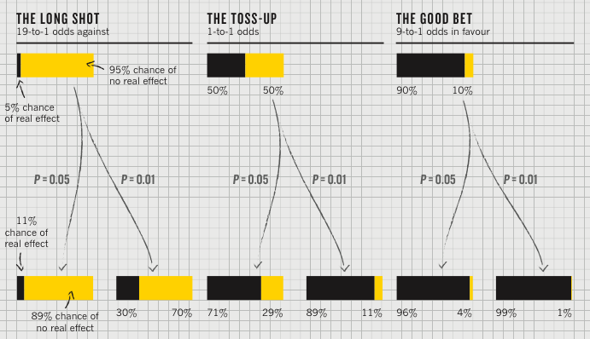
P value [Nuzzo]
P value
Best used to determine what is ‘worthy of a second look’ [Nuzzo]
Limited in its applicability

Slide 16
Plausibility of the hypothesis (inference)
P value
Best used to determine what is ‘worthy of a second look’ [Nuzzo]
Limited in its applicability
Before the
experiment

Slide 17
‘Statistical significance’
P value
Best used to determine what is ‘worthy of a second look’ [Nuzzo]
Limited in its applicability
Calculated p value
Notes:
Does not incorporate the inference (the top of this chart) directly

Slide 18
Actual implications of the p-value
P value
Best used to determine what is ‘worthy of a second look’ [Nuzzo]
Limited in its applicability
A small p makes the hypothesis more plausible
Notes:
Does not incorporate the inference (the top of this chart) directly

Slide 19
Potential Errors
 | Actually is: Same as Population | Actually is: Different than Population
Decision: is Same | H₀ (null): No difference | Type II error
Decision: is Different | Type I error | H₁: Real difference

Slide 20
Could our Estimate Be Wrong?
 | Actually is: Same as Population | Actually is: Different than Population
Decision: is Same | H₀ (null): No difference | Type II error
Decision: is Different | Type I error | H₁: Real difference
Erroneously detect a difference (false positive). Directly affected by p: at .05 we make a Type I error 5 out of 100 tries. .01 reduces this error to 1 out of 100 tries.

Slide 21
Could our Estimate Be Wrong?
 | Actually is: Same as Population | Actually is: Different than Population
Decision: is Same | H₀ (null): No difference | Type II error
Decision: is Different | Type I error | H₁: Real difference
Fail to detect a true difference (false negative) Indirectly affected by p: Depends on the size of the mean difference and the sample size.

Slide 22
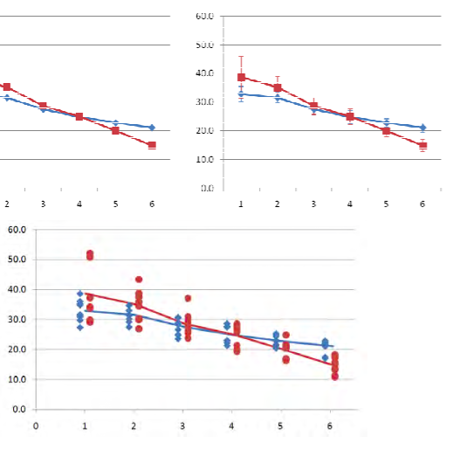
Reporting Should Help Document
Example Graphs [Dunlop]
Example Text
Minimum:
P value
Effect size
Verification of normality/independence
Sampling strategy
Good extras
Confidence Intervals
Power
Study plan (what was added/original)
Means only (bad) Means + error bars (minimal)
Means + Scatterplot (domain appropriate and informative)

Slide 23
What is a Cause?
Why is it hard to prove causality
Why do we need to prove causality?
Adapted from class by Samantha Kleinberg
Notes:
Observational data/no single method for finding Prediction/explanation/intervention

Slide 24
Causality has consequences
Sally Clark’s 1st son died in 1996, as a result of SIDS
Her 2nd son died in 1999, also as a result of SIDS
Prosecutors argued too unlikely to both be SIDS, must be murder.
Chance of SIDS = 1/8,543 so chance of 2 deaths = 1/(8,543*8,543) (approx 1 in 73 million)
What’s wrong with this?
Adapted from class by Samantha Kleinberg
Notes:
Meadow took a report estimating the chance
of SIDS as 1 in 8,543 and then said two would be one in 8,543*8,543 – approximately
73 million.1
Have you ever said it’s too unlikely to be true? Something unlikely has already happened!

Slide 25
Suppes
Pearl,
Granger
Lewis
SGS
Aristotle
Mackie
Hume
Mill
….
350 BCE
1739-40
1843
1965/74
1969
1973
1990s-
present
1970
Adapted from class by Samantha Kleinberg

Slide 26
Aristotle: four causes
Material: what something is made of
Components of my laptop
Formal: what it means to be something
Laptop is a portable computer
Efficient: source/producer of the thing
How apple transforms the materials into a laptop
Final: the purpose for doing something
Bought a laptop to make lecture slides
Adapted from class by Samantha Kleinberg
Notes:
Give examples. When we talk about causality we really mean production.
Four answers to why things are the way they are

Slide 27
Hume
C causes E if every event of type C is followed by another of type E
Billiard balls
One ball hits another and causes it to move
See all objects of similar type (ball) hit other objects of type (ball), where the second then begins to move
Adapted from class by Samantha Kleinberg

Slide 28

Regularities and experience
Past experience leads to expectation
Hear noise
Go to window
to verify
Prediction was false
Only with empirical evidence, can we make and test predictions
Adapted from class by Samantha Kleinberg

Slide 29
Problems with contiguity
Longterm causal processes
Childhood trauma, aggression as adult
Smoking and lung cancer
Tax policy and job growth
Remote causes
Absences
Not watering a plant and it dying
Adapted from class by Samantha Kleinberg
Notes:
What are some cases where there are real causes that are not contiguous?

Slide 30
Necessary connection
Effect always follows from cause
Effect is not produced without cause
C→E and E→C
not E or C AND not C or E
Thus, (not E and not C) or (C and E)
Adapted from class by Samantha Kleinberg

Slide 31
Problems with necessary connection
Multiple causes of an effect
Different ways of getting lung cancer, smoking not necessary
Probabilistic causes
Not every smoker gets lung cancer
Adapted from class by Samantha Kleinberg

Slide 32
Theory vs empiricism
Theoretical definition
Empirical definition
Contiguity
Temporal priority
Necessary connection
Contiguity
Temporal priority
Constant conjunction
Adapted from class by Samantha Kleinberg
Notes:
Contiguity: cause and effect are nearby
Temporal priority: cause occurs prior to effect
Constant conjunction: cause regularly followed by effect

Slide 33
Regularities - Mackie
Multiple causes for an effect
Multiple components of each cause
Making sure each really required, not just associated with others
Seatbelts
Risk taking
Actions of other drivers
Weather
Adapted from class by Samantha Kleinberg

Slide 34
Some definitions
Necessary condition: whenever E occurs, C occurs
Sufficient condition: whenever C occurs, E occurs
Adapted from class by Samantha Kleinberg

Slide 35
INUS condition
A cause is an insufficient (I) but non-redundant (N) part of an unnecessary (U) but sufficient condition (S)
Adapted from class by Samantha Kleinberg

Slide 36
INUS conditions
C is an INUS condition of E iff for X, Y: (C^X)v Y is necessary and sufficient condition of E, but C is not sufficient, and X is not sufficient
C ^ X is sufficient for E
C ^ X is not necessary for E
C may be insufficient by itself
C is non-redundant part of C ^ X
Adapted from class by Samantha Kleinberg

Slide 37
INUS example
Lit match (C) may cause house fire (E)
Many cases where lit match does not cause fire
Many cases of fire without lit match (Y)
For lit match to cause fire, need oxygen, flammable materials, etc. (X)
C
E
y
Adapted from class by Samantha Kleinberg

Slide 38
INUS conditions summary
X are conditions needed for C to cause the effect
Y is a set of sufficient conditions for E
C is INUS condition of E iff:
For some X and some Y (CX or Y) is necessary and sufficient condition of E
C is not a sufficient condition of E
X is not a sufficient condition of E
There are sets of conditions that result in effect, cause is necessary part of one of those sets.
Adapted from class by Samantha Kleinberg

Slide 39
Problems for INUS
Insufficient to rule out spurious relationships
Common cause of two effects
Chance regularities
Strength of contribution
Relative nature
Adapted from class by Samantha Kleinberg

Slide 40
Murder mystery
June 27, 2005: A sleepwalker, Benjamini Adoyo goes to sleep disorder clinic. Had been wandering through house, and sometimes shaking his wife while standing over her and babbling. He had no memory of these episodes.
August 10, 2005: After sleep study, center says he has non-REM parasomnia.
October 17, 2005: Visits clinic again. Medication increased.
October 19, 2005: Adoyo is arrested and charged with killing his wife
In general, parasomniacs can kill people with no intention, awareness or memory of committing the crime
Is it murder or a result of his sleep disorder?
The Case of the Sleeping Slayer. Scientific American, September 2012, p 34-39.

Slide 41
Sleepwalker or murderer?
911 call, 3:41 am October 19, 2005
Confessed, but was confused and asked about wife’s welfare
Core question: parasomnia was known prior to incident, but was it the cause of wife’s murder?
Operator: What’s going on?
Adoyo: You just get here
Operator: You need to tell me what’s going on.
Adoyo: Somebody is dead
Operator: Somebody is dead?
Adoyo: Yes.
Operator: Where are they at?
Adoyo: In their house. Somebody is dead. Get here.
Adapted from class by Samantha Kleinberg

Slide 42
The verdict
Wasn’t nearby wife (proximity is important)
Usually no motive, but had been arguing with wife
Assaulted wife in bedroom with hammer, chased into hall & bathroom, stabbed and strangled her
Unusual to see so many mechanisms at once
Adoyo pled guilty to second degree murder
Adapted from class by Samantha Kleinberg

Slide 43
Token causality
What happens in general, versus what happened in a particular instance
Parasomnia causing murder, versus parasomnia causing murder of Adoyo’s wife
Why do we need to talk about it separately?
Adapted from class by Samantha Kleinberg

Slide 44
Counterfactuals
How do we distinguish between things that are necessary in that they are required for the effect, and those that just co-occur?
Had things been different, what would have happened?
Adapted from class by Samantha Kleinberg

Slide 45
Counterfactuals and Hume
Day as a cause of night. Meets all three conditions
Definition (1): if use only first part of definition, still have correlation between day/night
Definition (2): removes causal connection between day/night. If day had not been, night would still exist
Adapted from class by Samantha Kleinberg

Slide 46
Counterfactual (basic idea)
Had C not have happened, E would not have either
Ex: umbrella vendors and rain
Adapted from class by Samantha Kleinberg
Notes:
Had cause not taken place, effect would not have happened either

Slide 47
Lewis: possible worlds
Mitt Romney is president
nearby possible world
actual world
Barack Obama is president
distant possible world
Lady GaGa is president
Adapted from class by Samantha Kleinberg
Notes:
obamaworld is closer to actuality than any other as it resembles the actual world more than any other

Slide 48
Comparing possible worlds
¬A, ¬C
¬A,C
¬ A, ¬ C
¬A, ¬C
A, ¬C
A,C
A,C
actual world, w
A, ¬C
¬A,C
A,C
A-worlds where C holds are closer to w than A worlds where C doesn’t hold
Adapted from class by Samantha Kleinberg
Notes:
Example from: http://seis.bris.ac.uk/~plajb/r

Slide 49
Counterfactual (definition)
Counterfactual of two propositions A and C:
A□→C: if A was true, C would be true
Truth condition: A□→C is true (in actual world w) iff:
No possible A-worlds (vacuous case) or
Some A-world where C holds is closer to w than is any A-world where C doesn’t hold
Adapted from class by Samantha Kleinberg

Slide 50
Causal dependence between events
Whether e depends on whether or not c
Represented by: c □→ e and ¬c □→ ¬ e
If each c_{i} depends causally on c_{i-1} and e depends causally on c_{n,}, then c₁ is a cause of e
C₁
C₂
C_{n}
E
. . .
Adapted from class by Samantha Kleinberg
Notes:
Conference -> trip to beijing -> jet lag

Slide 51
Causal chains
Previous example was a chain of causes
Causal relationship is transitive
Dependence relationship doesn’t have to be
e may still have occurred without c₁
Definition: c is a cause of e if e is causally dependent on c or if there is a chain of causal dependence between c and e.
Adapted from class by Samantha Kleinberg

Slide 52
Lewis’s update
“Whether” an event occurs is too strict
Really want to know cause made a difference to how & when it occurred
New definition: Where c and e are distinct events, c influences e if and only if there is a substantial range of c1, c2, … of different not-too-distant alterations of c (including the actual alteration of c) and there is a range of e1, e2, … of alterations of e, at least some of which differ, such that if c1 had occurred, e1 would have occurred, and if c2 had occurred, e2 would have occurred, and so on.
Adapted from class by Samantha Kleinberg

Slide 53
Why probabilistic causality?
Non-deterministic relationships
Radioactive decay
Incomplete knowledge
Even if food poisoning were deterministic, we still would not know all the conditions needed to bring it about
Capture how much of a difference cause makes to effect
Difference between oxygen and lit match for house fire
Adapted from class by Samantha Kleinberg

Slide 54
Probabilities from data
How to determine probability of heads/tails from coin flip?
Frequency of event x
#(x) = number of times it is observed
Relative frequency
#(x)/N, where N is number of observations
As N→∞, relative frequency →P(x)
Adapted from class by Samantha Kleinberg

Slide 55
Dependence/independence
Events that are independent
Flipping heads and then tails
Day of week and whether a patient had a heart attack (probably?)
Events that are dependent
Vice presidential candidate and presidential nominee
Diagnostic test being positive and whether patient has a disease
Adapted from class by Samantha Kleinberg

Slide 56
Conjunction
For independent events
P(A∧B)=P(A)P(B)
A∧B
A
B
Adapted from class by Samantha Kleinberg

Slide 57
Conditional probability
P(A∧B)=P(A|B)P(B), where P(B)>0
Note, if A and B independent, P(A∧B)=P(A)P(B)
Then:
Adapted from class by Samantha Kleinberg

Slide 58
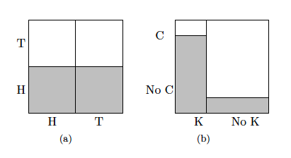
S. Kleinberg (2015) Why: A Guide to Finding and Using Causes. O’Reilly Media.

Slide 59
Example of Bayes rule
Probability of disease (d) is 0.001
But diagnostic test not foolproof
P(+|d) = 0.98
P(+|¬d) = 0.1
Given a positive test, what’s probability patient has disease?
Adapted from class by Samantha Kleinberg

Slide 60
Example continued
Adapted from class by Samantha Kleinberg

Slide 61
Why is understanding conditional probability important?
Sally Clark case
Mother whose first son died suddenly in 1996
Second son died similarly in 1998
SIDs or murder?
Case focused on statistic
Probability of death from SIDs = 1/8543
Probability of two deaths from SIDs = 1/8543*1/8543 ≈ 1/73 million!
See: www.statslab.cam.ac.uk/~apd/SallyClark_report.doc
Adapted from class by Samantha Kleinberg

Slide 62
Probabilistic causality: basic idea
C causes E if
P(E|C)>P(E)
Or P(E|C)>P(E|¬C)
Adapted from class by Samantha Kleinberg

Slide 63
Common cause principle
C is common cause of A and B if C is earlier than both and:
P(A^B|C)=P(A|C)P(B|C)
P(A^B|¬C)=P(A|¬C)P(B|¬C)
P(A|C)>P(A|¬C)
P(B|C)>P(B|¬C)
Adapted from class by Samantha Kleinberg

Slide 64
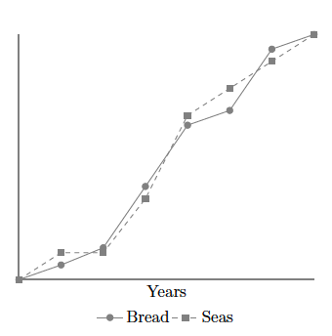
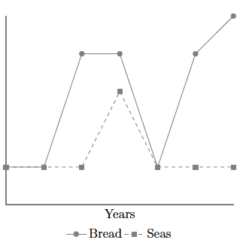
Problem: Nonstationarity
Sober, E. (2001). Venetian sea levels, British bread prices, and the principle of the common cause. The British Journal for the Philosophy of Science, 52(2), 331

Slide 65
Problem: Indeterminism
If lamp on, tv also on, so P(L|T)=1
Does switch screen off L and T?
0.9
lamp
switch
0.9
tv
Adapted from class by Samantha Kleinberg

Slide 66
Bias in graduate admissions?
 | Admit | Deny
Male | 3738 | 4704
Female | 1494 | 2827
P(admitted)= 5232/12763≈0.41
P(admitted|female) =1494/4321≈0.35
P(admitted|male)=3738/8442≈0.44
Bickel, P. J., Hammel, E. A., & O'connell, J. W. (1975). Sex bias in graduate admissions: Data from berkeley. Science, 187(4175), 398
Adapted from class by Samantha Kleinberg

Slide 67
Problem: Simpson’s paradox
 | Men |  | Women
Dept | Applied | % Admitted | Applied | Admitted
A | 825 | 62 | 108 | 82
B | 560 | 63 | 25 | 68
C | 325 | 37 | 393 | 34
D | 417 | 33 | 375 | 35
E | 191 | 28 | 393 | 24
F | 272 | 6 | 341 | 7
Adapted from class by Samantha Kleinberg

Slide 68
Simpson’s Paradox
http://en.wikipedia.org/wiki/Simpson's_paradox
Introducing another variable may change our understanding of the data
It may even reverse the initial conclusions

Slide 69
A situation where the subgroups are always the way to go
 | Treatment A | Treatment B
Small Stones | Group 1 93% (81/87) | Group 2 87% (234/270)
Large Stones | Group 3 73% (192/263) | Group 4 69% (55/80)
Both | 78% (273/350) | 83% (289/350)
Notes:
The practical significance of Simpson's paradox surfaces in decision making situations where it poses the following dilemma: Which data should we consult in choosing an action, the aggregated or the partitioned? In the Kidney Stone example above, it is clear that if one is diagnosed with "Small Stones" or "Large Stones" the data for the respective subpopulation should be consulted and Treatment A would be preferred to Treatment B. But what if a patient is not diagnosed, and the size of the stone is not known; would it be appropriate to consult the aggregated data and administer Treatment B? This would stand contrary to common sense; a treatment that is preferred both under one condition and under its negation should also be preferred when the condition is unknown.

Slide 70
Gender Discrimination?
 | Applicants | Admitted
Men | 8442 | 44%
Women | 4321 | 35%
Notes:
On the other hand, if the partitioned data is to be preferred a priori, what prevents one from partitioning the data into arbitrary sub-categories (say based on eye color or post-treatment pain) artificially constructed to yield wrong choices of treatments? Pearl[2] shows that, indeed, in many cases it is the aggregated, not the partitioned data that gives the correct choice of action. Worse yet, given the same table, one should sometimes follow the partitioned and sometimes the aggregated data, depending on the story behind the data; with each story dictating its own choice. Pearl[2] considers this to be the real paradox behind Simpson's reversal.

Slide 71
Gender Discrimination?
Dept | Men | Women
A | 825/62% | 108/82%
B | 560/63% | 25/68%
C | 325/37% | 593/34%
D | 417/33% | 375/35%
E | 191/28% | 393/24%
F | 373/6% | 341/7%
Bickel et al.[13]: women tended to apply to competitive departments with low rates of admission (English), men tended to apply to less-competitive departments with high rates of admission engineering and chemistry)
Notes:
On the other hand, if the partitioned data is to be preferred a priori, what prevents one from partitioning the data into arbitrary sub-categories (say based on eye color or post-treatment pain) artificially constructed to yield wrong choices of treatments? Pearl[2] shows that, indeed, in many cases it is the aggregated, not the partitioned data that gives the correct choice of action. Worse yet, given the same table, one should sometimes follow the partitioned and sometimes the aggregated data, depending on the story behind the data; with each story dictating its own choice. Pearl[2] considers this to be the real paradox behind Simpson's reversal.

Slide 72
Difficulties with probabilistic causality?
Adapted from class by Samantha Kleinberg

Slide 73
Problem: Causal chain
Each element in chain produces next with P=1
What happens?
Each element spurious aside from first – always an earlier cause to account for effect
C₁
C₂
C_{n}
E
. . .
Adapted from class by Samantha Kleinberg

Slide 74
Problem: Simpson’s paradox
Same problem as with common cause principle
Adapted from class by Samantha Kleinberg

Slide 75
Problem: Overdetermination
Bob and Susie throwing rocks at glass bottle
Rocks hit simultaneously, but Susie threw first
Susie Aims
Susie Throws
Bob Aims
Bob Throws
Glass Breaks
Time

Slide 76
Problem: Preemption
Bob’s rock arrives first and breaks glass
But Susie still threw first and has perfect aim (breaks glass with P=1)
Susie Aims
Susie Throws
Bob Aims
Bob Throws
Glass Breaks
Time

Slide 77
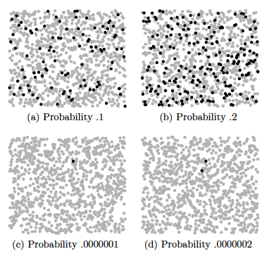
Problem: effect size
S. Kleinberg (2015) Why: A Guide to Finding and Using Causes. O’Reilly Media.
Notes:
Each dot represents 10,000 events, except in the lower two figures, where black
dots are single events.

Slide 78

Probability trajectory
Y
P(Y) changes at x
After x P(Y) is high
P is higher than before x
P remains high until y
Was Because Of!
x
Notes:
Image from: http://www.springerlink.com/content/vm062877643u8209/fulltext.pdf
http://carsguide.110mb.com/?l=Golf_ball
“A novice golfer swings at a golf ball and the ball begins rolling toward the cup. But a
squirrel comes along and kicks the ball away. Kicks of exactly this kind have a tendency to
prevent balls from making a birdie (reducing the probability of a birdie, say, from 0.5
to 0.1). Improbably enough (since there is only 10% of chance to make a birdie) and
luckily for the golfer, in this particular case, the ball comes off the squirrel’s foot on a
new trajectory (increasing the probability of a birdie to 0.7) to roll into the cup for a birdie
at a later time.”

Slide 79
Seatbelt should prevent death, but causes it

Slide 80
Ways of answering “why”?
Not just caused/didn’t cause, but what was role of cause in effect’s occurrence?
Anne drives drunk and crashes car. What’s significance of her drinking for the crash?
Could be
Because of
Despite
Independently of

Slide 81
y is because of x if
P(y) changes after x
P(y) is high after x
P(y) is higher than it was before x
P(y) remains high until it occurs

Slide 82
Four relations
Despite
y is Y despite x if the probability of Y is lowered after x_{t’}
Because
y is Y because of x if the probability of Y is increased after x_{t’} and remains increased until y_{t}
Autonomously
y is Y autonomously of x if the probability of Y changes at x_{t’}, this probability is high, but then decreases before y_{t}
Independently
y is Y independently of x if the probability of Y is the same just after x_{t’} as it is just before x_{t’}

Slide 83
The probability of death (D) within 30 minutes of poisoning (O) is 0.8
But if an antidote (A) is given within 10 minutes of poisoning, the probability of death is reduced to 0.001
However the antidote has occasional side effects, so the probability of death when an antidote is given in the absence of the poison is still 0.001
Is O a cause of death? Is A?

Slide 84
Poison and antidote
P(D|O)=0.8 in 30 minutes
P(D|A^O)=0.001 if within 10 minutes of O
P(D|A^¬O)=0.001
Are A and O positive, negative, neutral or mixed? Better handled by Suppes or Eells?
Can impact on a specific instance be different than that at type level? When?

Slide 85

Poison and antidote
X X
1
0.8
P(death)
0.001
antidote
t
Notes:
http://en.wikipedia.org/wiki/Poison

Slide 86
Why are background contexts needed?
What if poison and antidote are administered at same time?
What about exposure that provides resistance to later bacteria?

Slide 87
Counterexample (sort of)
C likely to survive until t2 but not a later time
P(death|A)=P(death|disease)
P(death|cure)=0
BUT residual chance of death from A
C
A
B
Patient
Ineffective drug
Cure
t
t1
t2
time

Slide 88
Caveats
How can we know all the important factors?
How can we find the probability trajectory?

Slide 89
Recap of first section
Main approaches
Regularities
Counterfactuals
Probabilistic causality
Omitted: interventionist
Two problems
Type level
Token level

Slide 90
What’s probability a smoker with fatigue has cancer?
Smoking
Chronic bronchitis
Lung cancer
Fatigue
Mass on X-ray
Read D. Heckerman. A tutorial on learning with Bayesian networks. http://research.microsoft.com/en-us/um/people/heckerman/tutorial.pdf
Sections 1-5

Slide 91
Why graphical models?
Smoking | Chronic Bronchitis | Lung Cancer | Fatigue | Mass on X-ray | P(S,CB,LC,F,M)
F | F | F | F | F | 0.2
F | F | F | F | T | 0.1
 | … |  |  |  | …
T | T | T | T | T | 0.4
n binary variables = 2^n entries

Slide 92
Graphical model
Describes independencies in a set of variables
Directed
Bayesian network

Slide 93
Graphical model and independencies
A node X is independent of its non-descendants given its parents
Smoking (S)
Chronic bronchitis (C)
Lung cancer (L)
Fatigue (F)
Mass on X-ray (M)

Slide 94
Instead of 2^5 parameters:
P(S): 2
P(C|S): 4
P(L|S): 4
P(F|C,L)=8
P(M|L)=2
 | P(C=T) | P(C=F)
S=T | 0.25 | 0.75
S=F | 0.05 | 0.95
P(S=T) | P(S=F)
0.2 | 0.8
Smoking (S)
Chronic bronchitis (C)
Lung cancer (L)
 | P(L=T) | P(L=F)
S=T | 0.003 | 0.997
S=F | 0.000005 | 0.99995
 | P(F=T) | P(F=F)
C=T,L=T | 0.75 | 0.25
C=T,L=F | 0.10 | 0.90
C=F,L=T | 0.50 | 0.50
C=F,L=F | 0.05 | 0.95
Fatigue (F)
Mass on X-ray (M)
 | P(M=T) | P(M=F)
L=T | 0.6 | 0.40
L=F | 0.02 | 0.98
Notes:
Compare to truth table with 2^N rows

Slide 95
Creating a graphical model
For X₁,X₂,…X_{n,:}
-Add X_{i} to graph
-Add edges from pa(X_{i}) where
P(X_{i}|X₁…X_{i-1})=P(X_{i}|pa(X_{i}))
-Add conditional probability P(X_{i}|pa(X_{i}))
Pearl, J (1988) Probabilistic Reasoning in Intelligent Systems

Slide 96
Example (1)
Coin A, Coin B
What’s Bayesian network?
A
B

Slide 97
Example (2)
Cavity, Toothache
Possible BNs?
C
T
C
T

Slide 98
Example (3)
Barometer, Rain, Air Pressure
Possible BNs?
B
A
R
B
A
R
B
A
R

Slide 99
Inference
Unconditional probability
Probability of variable(s) taking particular values
Probability of smoking and asbestos exposure
How to find probability of variable(s) of interest given what is known (posterior)
Probability of query given evidence
Probability of disease | symptoms, test result
Finding most likely value of variables given evidence
Diagnosis given set of symptoms

Slide 100
Inference
Unconditional probability
Probability of variable(s) taking particular values
Probability of smoking and asbestos exposure
How to find probability of variable(s) of interest given what is known (posterior)
Probability of query given evidence
Probability of disease | symptoms, test result
Finding most likely value of variables given evidence
Diagnosis given set of symptoms

Slide 101
Variable elimination with evidence
Now want to calculate probability of variable given what we know about value of other variables
Say we know someone visited Asia and had Dyspnea, how to take that into account when calculating probability their x-ray will be positive?
Last week’s mystery!

Slide 102
Inference
Unconditional probability
Probability of variable(s) taking particular values
Probability of smoking and asbestos exposure
How to find probability of variable(s) of interest given what is known (posterior)
Probability of query given evidence
Probability of disease | symptoms, test result
Finding most likely value of variables given evidence
Diagnosis given set of symptoms

Slide 103
Approximate inference
Sampling
Basic idea: Generate set of samples (instantiations of graph), use to calculate probability. As sample size increases, approaches actual values.
Rejection sampling: Have values for some variables (evidence), ignore samples with different values
Importance sampling: Use evidence to weight sampling

Slide 104
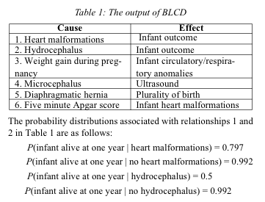
Application: infant mortality
Mani, S., & Cooper, G. F. (2004). Causal Discovery Using a Bayesian Local Causal Discovery Algorithm. Proceedings of MedInfo, 731-735

Slide 105
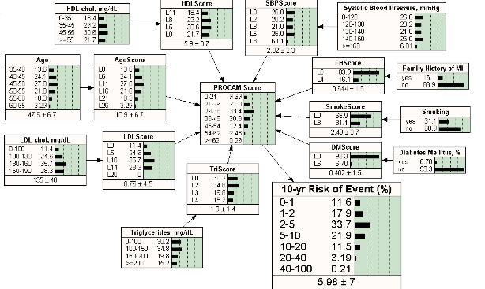
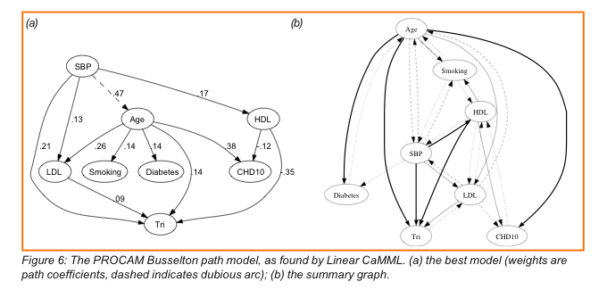
Application: epidemiology
Twardy, C. R., Nicholson, A. E., Korb, K. B., & McNeil, J. (2006). Epidemiological data mining of cardiovascular bayesian networks. Electronic Journal of Health Informatics, 1(1), e3

Slide 106
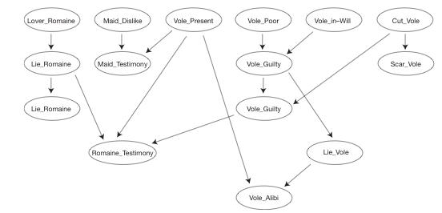
Application: Organizing evidence
Lagnado, D. (2011). Thinking about Evidence. In Proceedings of the British Academy (Vol. 171, pp. 183-223)
Notes:
Witness for the prosecution

Slide 107
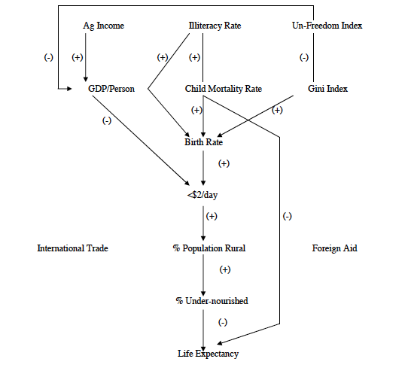
Application: Causes and effects of poverty
Bessler, D. A. (2003). On world poverty: Its causes and effects. Food and Agricultural Organization (FAO) of the United Nations, Research Bulletin, Rome

Slide 108
Applications of causal BNs
Biomedical informatics – diagnosis, prognosis
Psychology – representation of causal learning
Economics/finance

Slide 109
Causal graph
Arrows denote direct causes
Edge from X to Y means X causes Y
DAG
S. Kleinberg (2015) Why: A Guide to Finding and Using Causes. O’Reilly Media.

Slide 110
Completeness of graph
Complete: all common causes included, all causal relations among variables included
Incomplete: not all intermediate factors necessarily included

Slide 111
Faithfulness
Exactly the dependencies in the underlying structure hold in the data
i.e. Independence relations not from chance but from structure
No canceling out

Slide 112
Example
Smoking
-
+
Exercise
Health
+

Slide 113
Another example
Gene A
-
+
Gene B
Phenotype
+
Notes:
Backup causes. Gene A downregulates B

Slide 114
Selection bias
fever
Abdominal pain
F+ A
Stay home
Go to hospital
Cooper, G. F. (1999). An overview of the representation and discovery of causal relationships using bayesian networks. In C. Glymour & G. F. Cooper (Eds.), Computation, causation, and discovery. AAAI Press and MIT Press

Slide 115
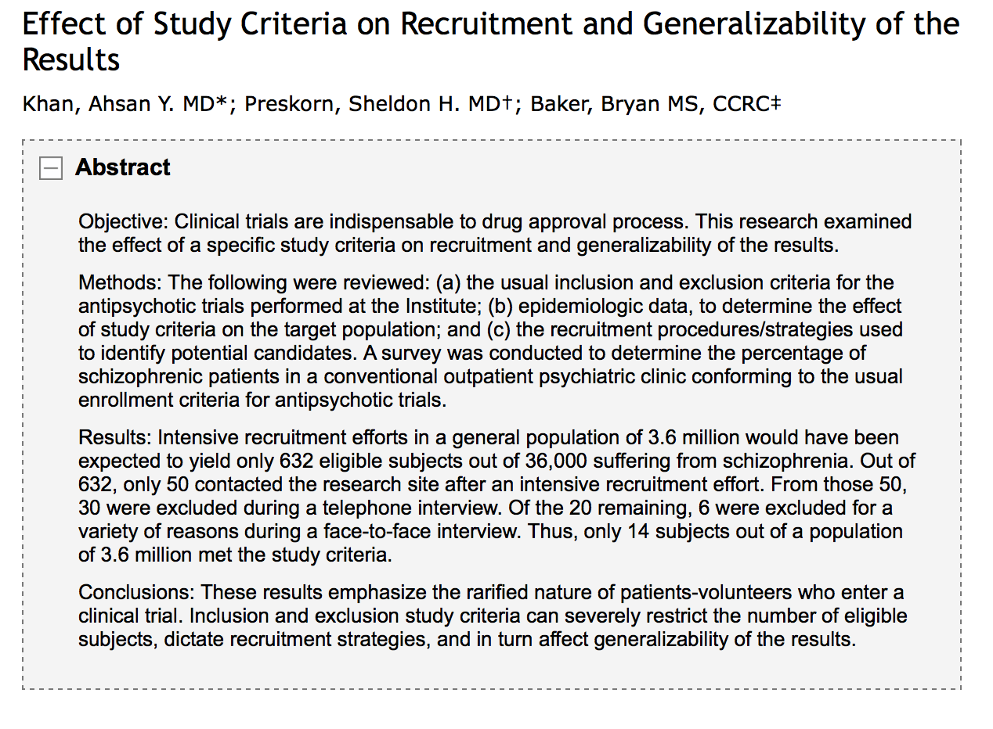

Slide 116
Recap of problems for faithfulness
Only true in large sample limit
Simpson’s paradox
Selection bias
Statistical tests

Slide 117
Quick recap
CMC: population produced by structure has these independencies
Faithfulness: population has only these independencies Why do we need both?
X
Y
Z

Slide 118
Causal sufficiency
All common causes of pairs of variables measured
Not sufficient if Y not measured
Y
X
Z

Slide 119
Completeness vs. sufficiency
Completeness: common causes are included in causal graph
Sufficiency: all common causes have been measured

Slide 120
Example
Intelligence
X
Y
Z
Scheines, R. (1997). An introduction to causal inference. Causality in Crisis, 185-99

Slide 121
What if no causal sufficiency?
Need to include all graphs with unmeasured common causes.
Ex: measured A, B, C. Found A ╨ C. With CMC, faithfulness but no causal sufficiency, the following graphs are all possible (X is unmeasured):
A
C
A
C
A
C
X
X
. . .
B
B
B

Slide 122
In absence of sufficiency…
Can still learn something
Some relationships may appear in all graphs
Can find set of all graphs representing independence relations, with nodes for possible hidden variables
Timing information helps

Slide 123
Things to beware of with inference
Sample size
Missing data (not just variables)
Multiple testing (and FDR)
What structures DAG can/cannot represent (e.g. time series and feedback)
Variable representation

Slide 124
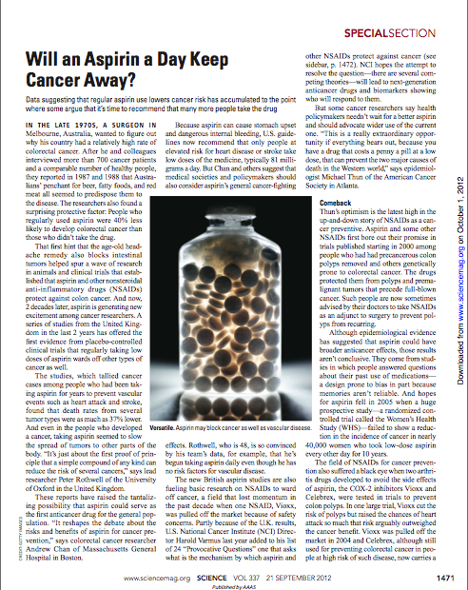
Predicting the effects of actions

Slide 125
Cloudy
What’s P(C) if I turn the sprinkler on?
Is this the same as P(C|S=T)?
Sprinkler
Rain
Wet grass

Slide 126
Actual causality
Pearl: token cause = actual cause
What caused a person’s lung cancer?
Who is responsible for an accident

Slide 127
Graphical models and explanation
Graphical model that represents relationships between variables
Observations give truth value of variables in particular scenario
Use model to evaluate counterfactual queries

Slide 128
Pearl’s approach to actual cause
Based on but attempts to solve problems with counterfactuals
Bob and Susie and the broken bottle
Key idea: sustenance (mix of necessity and sufficiency)
If Bob’s rock missed, would Susie’s sustain the glass breaking?

Slide 129
Definitions
Depends (necessity)
y depends on x, if x is necessary to maintain value of y
Produces (sufficiency)
x can produce y if it can bring about effect when neither are present
Sustains
x sustains y if there is at least one condition where Y will differ from y in absence of x AND Y=y is maintained in presence of x under any set of conditions

Slide 130
Causal Beams
Causal beam: New model, where we remove all parents except those that minimally sustain their children. Set other parents to some w’.
x is actual cause of y if x is necessary for y in that causal beam for some w’

Slide 131
Inference recap
 | BN | DBN | Granger | Temporal logic
Results | Graph
Time | No
Data | C/D/M
Cycles | No
Latent vars. | Yes
Prediction | Yes
Token cause | Counterfactual -based
 | BN | DBN | Granger | Temporal logic
Results | Graph | Graph | Relationships | Relationships
Time | No | Set of lags | Single lag* | Window
Data | C/D/M | C/D/M* | C | D/M
Cycles | No | Yes | Yes | Yes
Latent vars | Yes | Yes | No | No
Prediction | Yes | Yes | No | No
Token cause | Counterfactual-based | No | No | Probabilistic

Slide 132
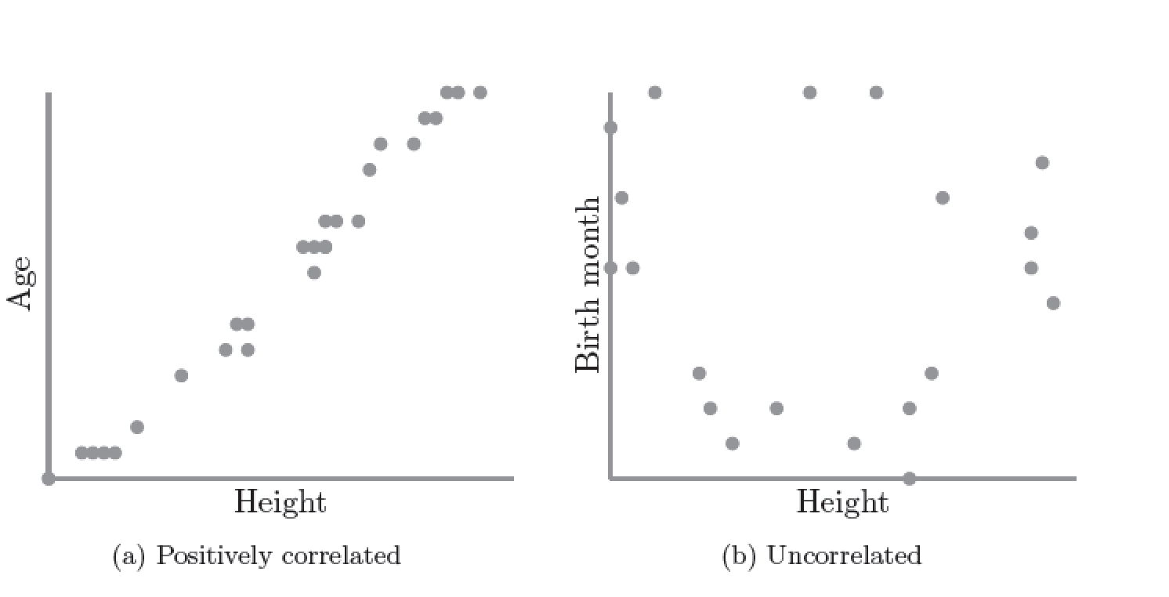
Correlation
S. Kleinberg (2015) Why: A Guide to Finding and Using Causes. O’Reilly Media.

Slide 133
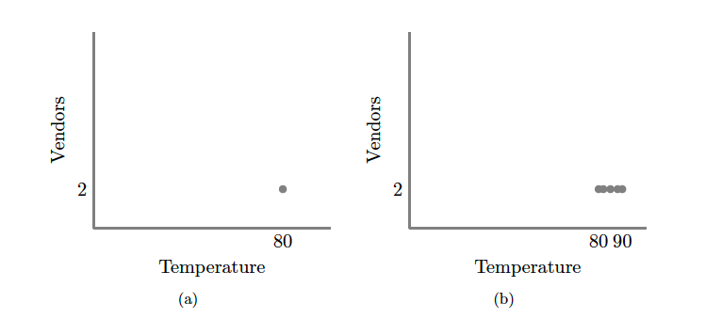
S. Kleinberg (2015) Why: A Guide to Finding and Using Causes. O’Reilly Media.
Notes:
No correlation without variation. Note: this is what happens if you ask only winners why they won

Slide 134
Scatter Plots and Correlation
A correlation analysis are measures of association (relationship) between two variables
These variables change together
Usually scale (interval or ratio) variables
Analysis techniques limited to linear relationships

Slide 135
What is “Linear”?
Remember this:
Y=mX+B?
m (slope)
B (intercept)
Adapted from: http://www.sjsu.edu/people/steven.macramalla/courses/stats95/s1/lecture 10
Notes:
A slope of 2 means that every 1-unit change in X yields a 2-unit change in Y.

Slide 136
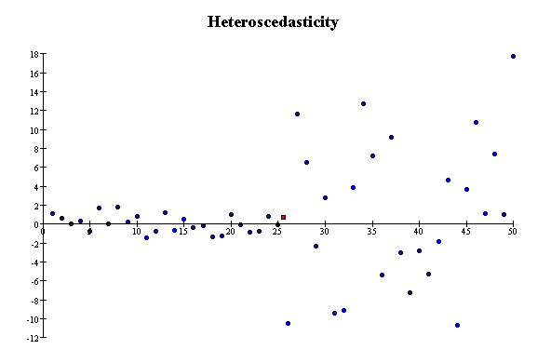
Correlation Assumptions
Key Assumptions:
X values are normally distributed within the population (for each Y)
Y values are normally distributed within the population (for each X)
X and Y have a linear relationship
There are no significant outliers
Scatter doesn’t vary over X or Y

Slide 137
Residual Analysis for Linearity
y
y
x
x
residuals
x
x
residuals
✓
Not Linear
Linear
Slide from: Statistics for Managers Using Microsoft® Excel 4th Edition, 2004 Prentice-Hall

Slide 138
Residual Analysis for Constant Variance (Homoscedasticity)
y
y
x
x
residuals
x
x
residuals
✓
Non-constant variance
Constant variance
Slide from: Statistics for Managers Using Microsoft® Excel 4th Edition, 2004 Prentice-Hall

Slide 139
Residual Analysis for Independence
✓
Not Independent
Independent
residuals
X
residuals
X
residuals
X
Slide from: Statistics for Managers Using Microsoft® Excel 4th Edition, 2004 Prentice-Hall

Slide 140
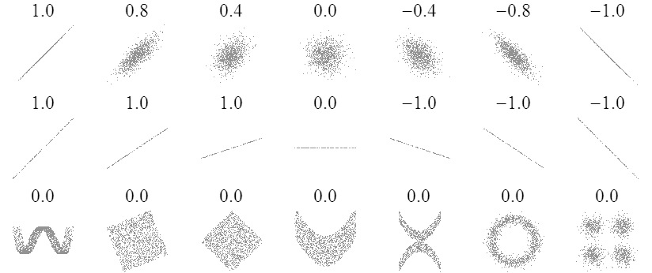
Sample Correlations
Adapted from: http://www.sjsu.edu/people/steven.macramalla/courses/stats95/s1/lecture 10
140

Slide 141
Pearson Correlation Coefficient
(continued)
The population correlation coefficient ρ (rho) measures the strength of the association between the variables
The sample correlation coefficient r is an estimate of ρ and is used to measure the strength of the linear relationship in the sample observations
Adapted from http://www.fordham.edu/economics/Vinod/correl-regr.ppt

Slide 142
Calculating the Pearson Correlation Coefficient
Sample correlation coefficient:
or the algebraic equivalent:
where:
r = Sample correlation coefficient
n = Sample size
x = Value of the independent variable
y = Value of the dependent variable
Adapted from http://www.fordham.edu/economics/Vinod/correl-regr.ppt

Slide 143
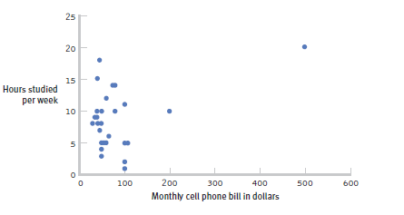
The effect of outliers
One outlier changed the correlation from -0.14 to 0.39!
Adapted from: http://www.sjsu.edu/people/steven.macramalla/courses/stats95/s1/lecture 10
Notes:
Note negative to positive change among other things
----- Meeting Notes (2/19/15 10:00) -----
cook's distance

Slide 144
Measuring correlation
Cups of coffee (X) vs. correct test answers (Y)
X | Y
0 | 1
1 | 1
3 | 3
4 | 5
5 | 5
Notes:
Mean of X 2.6, mean of y 3
Coffee is as related to correct answers as vice versa

Slide 145
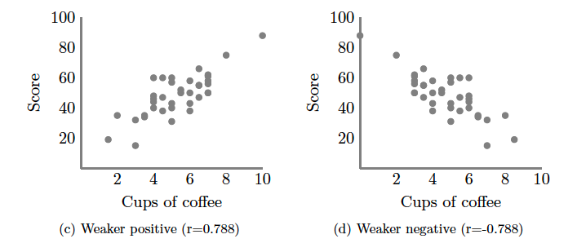
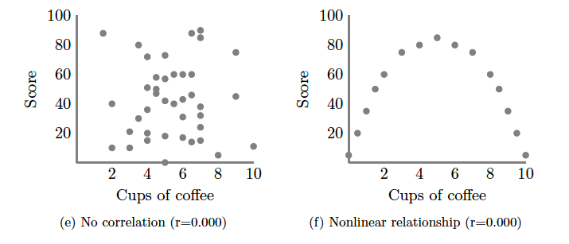
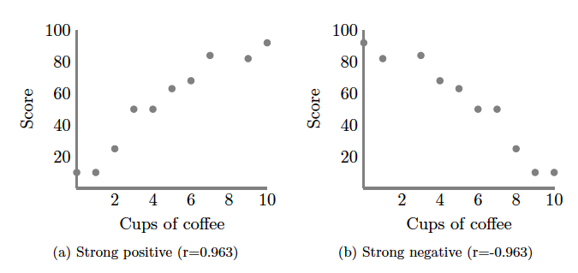
S. Kleinberg (2015) Why: A Guide to Finding and Using Causes. O’Reilly Media.

Slide 146
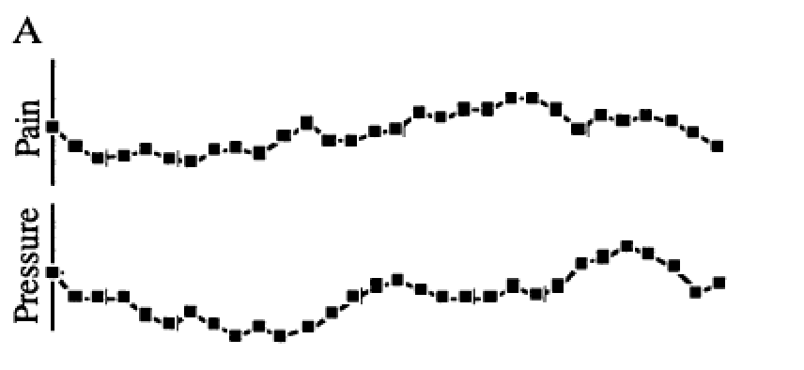
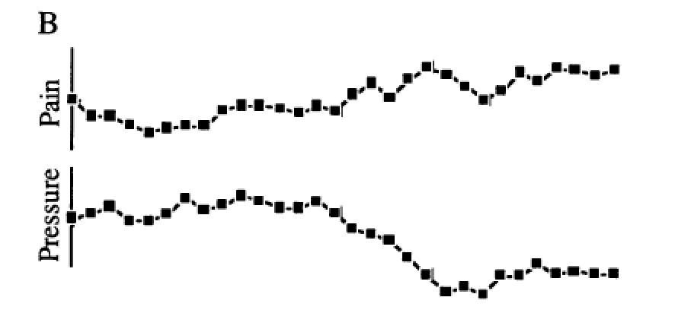
Correlation = 0!
Redelmeier DA, Tversky A (1996) On the belief that arthritis pain is related to the weather. Proceedings of the National Academy of Sciences 93(7):2895-2896.
Notes:
Cognitive bias
Fig. 1A were judged as positively related by 87%, as negatively related by 2%, and as unrelated by 11% of participants. The two uncorrelated sequences in Fig. 1B were judged as positively related by 3%, as negatively related by 79%, and as unrelated by 18% of participants.
----- Meeting Notes (8/31/15 17:30) -----
reformant

Slide 147
Common Statistical Tests
P value
Correlation
Measures association (linear relationship) between two variables
These variables change together
Usually scale (interval or ratio) variables
Limited in its applicability to normal, linearly related data with consistent scatter and no outliers
Often mistaken for causation
Notes:
changes in a few data-analysis decisions can increase the false-positive rate in a single study to 60%.

Slide 148
Correlation is not Causation
There is a 0.91 correlation between ice cream consumption and drowning deaths.
Does eating ice cream cause drowning?
Does grief cause us to eat more ice cream?
Adapted from: http://www.sjsu.edu/people/steven.macramalla/courses/stats95/s1/lecture 10

Slide 149
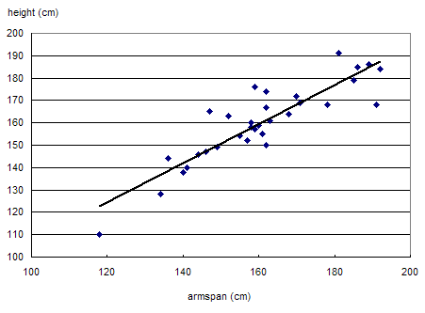
Correlation is not Causation
Armspan and height are strongly correlated.
Adapted from: http://www.sjsu.edu/people/steven.macramalla/courses/stats95/s1/lecture 10

Slide 150
Common Statistical Tests
P value
Correlation
Measures association (linear relationship) between two variables
These variables change together
Usually scale (interval or ratio) variables
Limited in its applicability to normal, linearly related data with consistent scatter and no outliers
Often mistaken for causation
Range restriction & other manipulations can affect or even reverse outcomes (Simpson’s paradox)
Notes:
changes in a few data-analysis decisions can increase the false-positive rate in a single study to 60%.

Slide 151
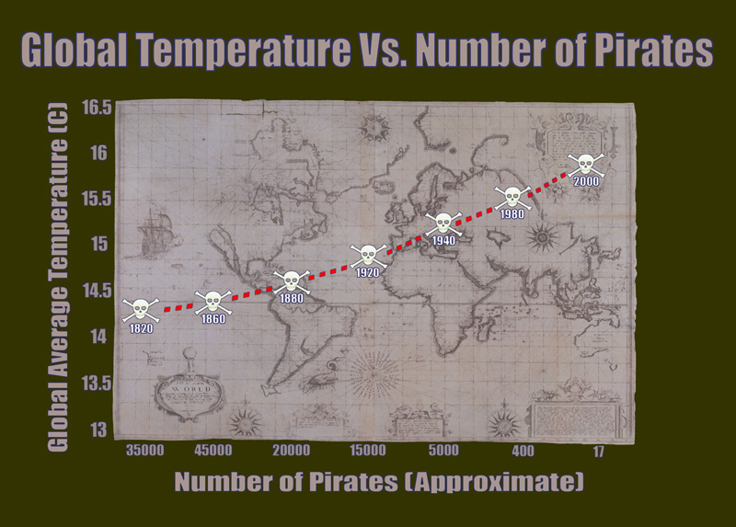
Correlation without causation (1)
http://bama.ua.edu/~sprentic
Notes:
http://bama.ua.edu/~sprentic/101%20Psych%20&%20Life--Correlation-causation.htm
But why shouldn’t we use pirates to predict temperature?
Now, why do we think pirates don’t cause global warming, or global warming doesn’t cause piracy?

Slide 152

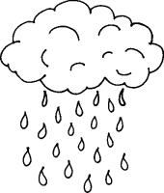
Correlation with some causation
Notes:
Directionality = why we can’t use it for prediction!
Umbrella vendors out before rain
Observe out of order

Slide 153
Some reasons X and Y may be correlated
X causes Y
Y causes X
Z causes both X and Y
Time series nonstationary

Slide 154
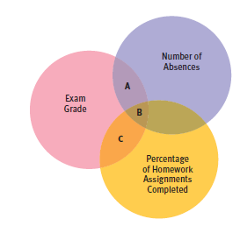
Partial Correlation
Quantifies the degree of association between two variables after statistically removing the association of a third variable with both of those two variables.
e.g., number of absences and exam grade, over and above the correlation of percentage of completed homework assignments with these variables.
Adapted from: http://www.sjsu.edu/people/steven.macramalla/courses/stats95/s1/lecture 10

Slide 155
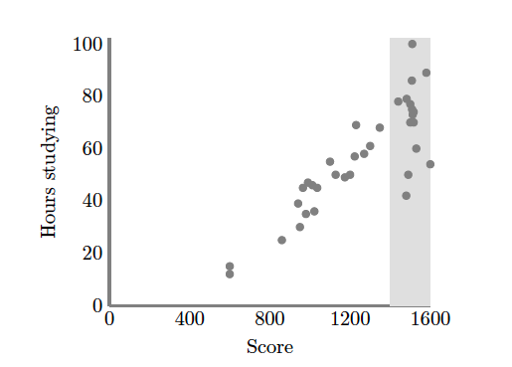
Causation without correlation
S. Kleinberg (2015) Why: A Guide to Finding and Using Causes. O’Reilly Media.
Notes:
Restricted range. Only observing grey area
Illustrate restricted range on board. When else does that happen? Surveying political website users

Slide 156
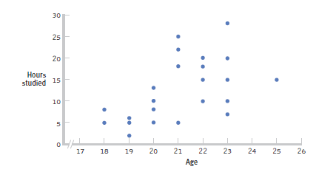
Restricted Range: Sampling Bias
Boys and girls who performed in the top 2% to 3% on standardized
Adapted from: http://www.sjsu.edu/people/steven.macramalla/courses/stats95/s1/lecture 10
Notes:
tests - a much smaller range than the full population from which the researchers could have drawn their sample.

Slide 157
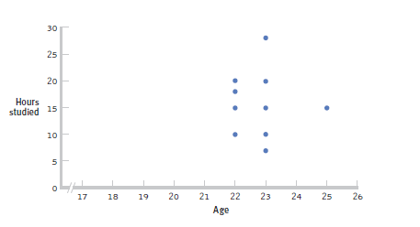
Further Restrictions
Only students between the ages of 22 and 25: r= 0.05.
Adapted from: http://www.sjsu.edu/people/steven.macramalla/courses/stats95/s1/lecture 10

Slide 158
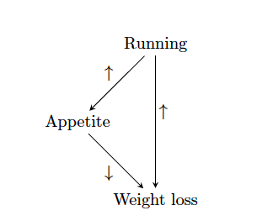
Causation without correlation
S. Kleinberg (2015) Why: A Guide to Finding and Using Causes. O’Reilly Media.
Notes:
But in addition to correlation without causation, we can have causation without correlation

Slide 159
Causation without correlation
Treatment
 | Dead | Alive
A | 85 | 215 (72%)
B | 59 | 241 (80%)
Total | 144 | 456
Notes:
Treatment B is standard, A is experimental approach
Who wants treatment A and who wants treatment B?

Slide 160
Causation without correlation (2)
Treatment | Men |  | Women |  | Combined
 | Dead | Alive | Dead | Alive | Dead | Alive
A | 80 | 120 (60%) | 5 | 95 (95%) | 85 | 215 (72%)
B | 20 | 20 (50%) | 39 | 221 (85%) | 59 | 241 (80%)
Total | 100 | 140 | 44 | 316 | 144 | 456
Baker SG, Kramer BS (2001) Good for women, good for men, bad for people: Simpson's paradox and the importance of sex-specific analysis in observational studies. Journal of women's health & gender-based medicine 10: 867-872
Notes:
http://www.ncbi.nlm.nih.gov/pubmed/11747681
Ask: so what actually happened?
Levels of granularity matter!!!
Men have higher mortality rate, and more of them got treatment A than B, biasing the sample and vice versa with women.

Slide 161
Common Statistical Tests
P value
Correlation
Measures association (linear relationship) between two variables
These variables change together
Usually scale (interval or ratio) variables
Limited in its applicability to normal, linearly related data with consistent scatter and no outliers
Often mistaken for causation
Range restriction & other manipulations can affect or even reverse outcomes (Simpson’s paradox)
Cannot easily determine if there is a mediating variable
Notes:
changes in a few data-analysis decisions can increase the false-positive rate in a single study to 60%.

Slide 162
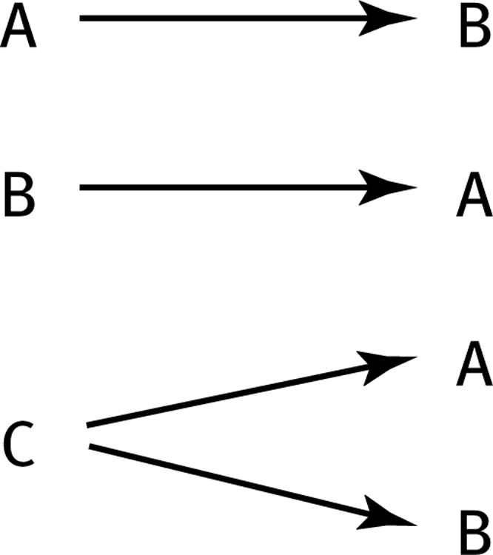
How can we test these associations?
Three Possible Causal Explanations for a Correlation
Adapted from: http://www.sjsu.edu/people/steven.macramalla/courses/stats95/s1/lecture 10

Slide 163
Explanation (1)
Why are two variables related?
Diabetes
Blurred vision
Weight loss
CKD
Renal failure
medication
Notes:
We do not want to know only that a
particular drug is associated with renal failure, but rather want to distinguish
between whether this association is due to an adverse drug reaction or the
disease being treated causing both renal failure and prescription of the drug.

Slide 164
Explanation (2)
General causes of illness vs. cause of a specific patient’s illness
Why did an event happen?
Why did a particular person develop lung cancer at age 42?
What led to the U.S. recession in 2007?
Is a stroke patient’s secondary brain injury due to seizures?
Ronald Opus
Notes:
Ch 6 of book? Motivate why we need to automate this reasoning?

Slide 165
Recap
A cause
….allows prediction of future events
….explains connections
….explains occurrences
….enables interventions to prevent/produce outcomes
BUT! Not every cause does and the story is more complicated

Slide 166
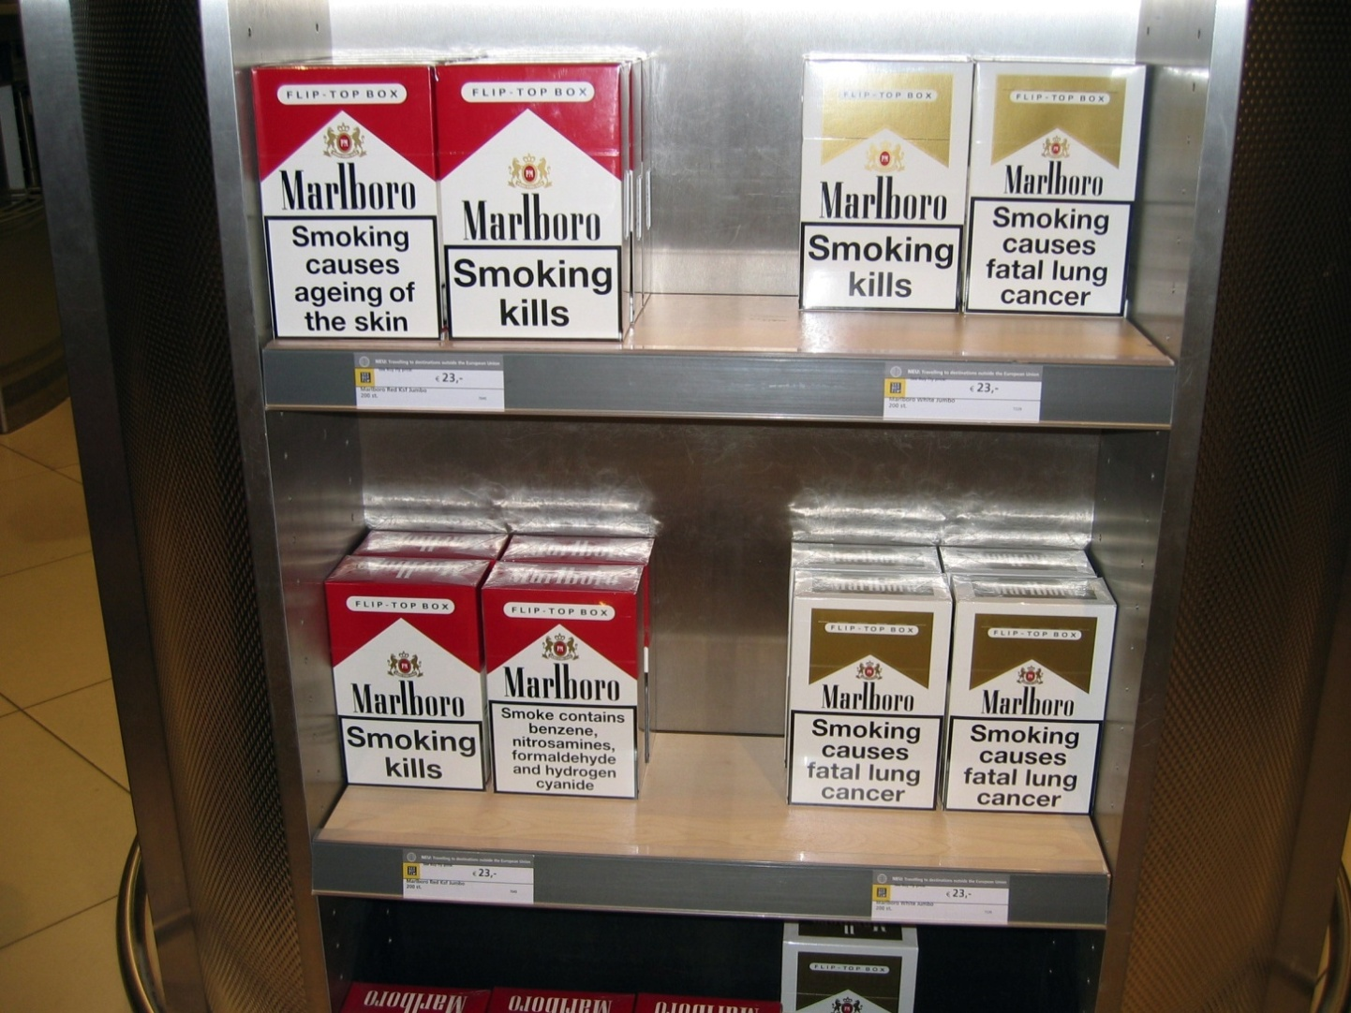
Causality & time
CUMC Neuro-ICU
Notes:
http://www.ski-epic.com/london_amsterdam_2005/
“Feel free to use any pictures found here for any purpose you like, with or without credit. I grant you full rights, for free, forever, to do anything you want, including redistribute the pictures with or without any credit to me”

Slide 167
Interpretation in the absence of time
Compare:
A. Smoking causes lung cancer with probability ≈ 1 after 90 years
B. Smoking causes lung cancer with probability = ½ in less than 10 years.
Notes:
Timing of effect
When to buy/sell stock
When is medication effective

Slide 168
Probability
Few relationships deterministic
Relationship vs. limits of knowledge
Understanding risk
Choosing intervention target
Medication efficacy vs. side effects
Can also measure strength of relationship

Slide 169
Complexity
Interactions
Smoking + lung cancer: other conditions affecting probability and time: genetics, environment
Planning effective interventions
Political Speeches
Durations, conjunctions, sequences of events

Slide 170
Does coffee prevent or hasten death?
Notes:
Activity
Pair up.
Take 2 minutes, each read ONE.
Discuss, try to come to consensus on role of coffee. What evidence is most compelling?

Slide 171

Features of ρ and r
Unit free
Range between -1 and 1
The closer to 0, the weaker the linear relationship
Does not imply causality!
Adapted from http://www.fordham.edu/economics/Vinod/correl-regr.ppt

Slide 172
Summary
Start with process data and analysis, only then explore frequency data and analysis
Notes:
Note: Add a little more about the last point

Slide 173
Summary
Start with process data and analysis, only then explore frequency data and analysis
Most statistical tests
depend on the central limit theorem and thus its assumptions
The sample is normal
If multiple samples, they are independent & have the same variance
return estimates and can make two kinds of errors (Type I and Type II)
Can only reject hypotheses
Notes:
Note: Add a little more about the last point

Slide 174
Summary
Start with process data and analysis, only then explore frequency data and analysis
Most statistical tests depend on normal data
What if the data are not normal?
Use a non-parametric test (no assumptions about the distribution of the sample; but may have other assumptions)
Notes:
Note: Add a little more about the last point

Slide 175
Summary
Start with process data and analysis, only then explore frequency data and analysis
Most statistical tests depend on normal data
Interpreting results must be done with respect to real world expectations about the population
Notes:
Note: Add a little more about the last point

Slide 176
Summary
Start with process data and analysis, only then explore frequency data and analysis
Most statistical tests depend on normal data
Interpreting results must be done with respect to real world expectations about the population
Potential pitfalls include
Low rate of replication of findings [Ionnadis]
Bias (‘findings’ may actually be measuring bias) [Ionnadis]
Low power (probability of rejecting a false hypothesis) in studies [Colquhuon]
Lack of careful data exploration (charts & summarization) [Hart]
Notes:
Note: Add a little more about the last point

Slide 177
Review, continued…
Sampling choices bias results or even turn them on their head! (this latter issue is called Simpson’s Paradox). Sometimes we should subsample; sometimes we should not

Slide 178
Example
A study of graduates’ salaries showed negative association between economists’ starting salary and the level of the degree
PhDs earned less than Masters degree holders, who in turn earned less than those with just a Bachelor’s degree
Why?
The data was split into three employment sectors
Teaching, government and private industry
Each sector showed a positive relationship
Employer type was confounded with degree level
Adapted from: http://www.sjsu.edu/people/steven.macramalla/courses/stats95/s1/lecture 10

